Slide 1
MONTHLY CALENDER
By: Manjunath Tolagatti

Slide 2
Definition
The MonthlyCalendar control allows the user to select a date using a visual display.
You can limit the date and times that can be selected by setting the MinDate and MaxDate properties.
You can change the look of the calendar portion of the control by setting the ForeColor

Slide 3
PROPERTIES
Date properties:
Min Date: 1/1/1753
Max Date: 12/31/9998

Slide 4
PROPERTIES
BackColor
ForeColor
TitleBackColor
TitleForeColor
TrailingForeColor

Slide 5
PROPERTIES
SelectionRange.
The SelectionRange property, as well as the SelectionStart and SelectionEnd properties, allow you to get the dates that are selected in the form of two DateTime values. These are the start and end dates.
ShowToday. There are two properties that allow you to change whether and how the "Today" text at the bottom of the calendar appears. ShowToday is by default set to true. If you set it to false, it will not be present at the bottom of the calendar.

Slide 6
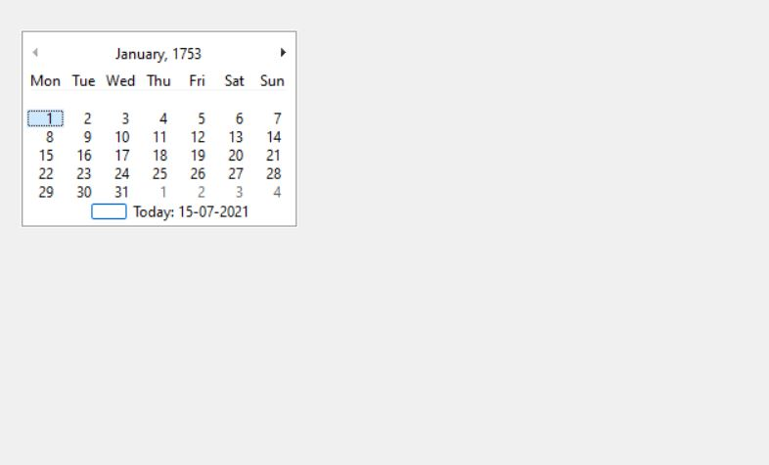
OUTPUT WINDOW

Slide 7
NUMERIC UP DOWN

Slide 8
Definition
NumericUpDown control contains a single numeric value that can be incremented or decremented by clicking the up or down buttons of the control.
The user can also enter in a value, unless the ReadOnly property is set to false .

Slide 9
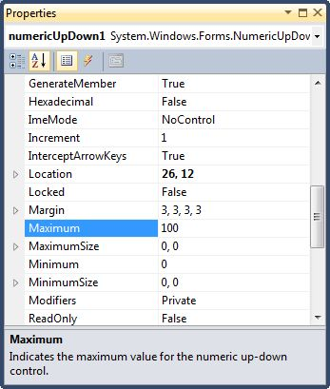
PROPERTIES

Slide 10
PROPERTIES
The Increment property determines how far the NumericUpDown will change its value up or down depending on the arrow clicked. Sometimes it may be useful to increase the number by more than 1 or less than one.
The DecimalPlaces property allows you to set the number of digits that come after the decimal place in the NumericUpDown control. Again, this property may be useful in some programs that use the NumericUpDown but not in many others.

Slide 11
PROPERTIES
The ThousandsSeparator property gives you a culture-sensitive thousands separator. For a US English culture, this will cause the number 1000 to be displayed with a comma. We see the value 1,000.
Hexadecimal property. It is possible to have the NumericUpDown control display its numbers in hexadecimal format using this property and setting it to True

Slide 12
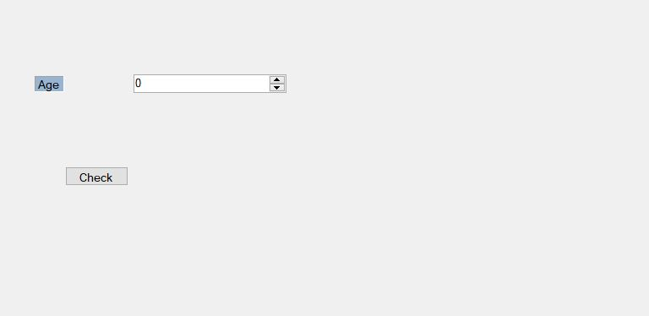
OUTPUT WINDOW

Slide 13
THANK YOU

